Slide 1
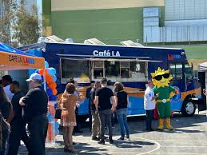
FOOD SERVICES DIVISION POLICIES & PROCEDURES
12.15.2023

Slide 2
OBJECTIVE
The objective of this training is to establish an understanding and working knowledge of the District’s and Food Services Division’s Policies and Procedures.

Slide 3
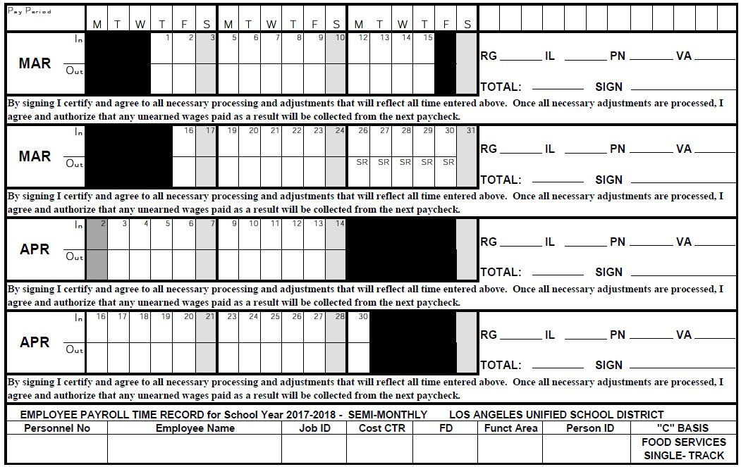
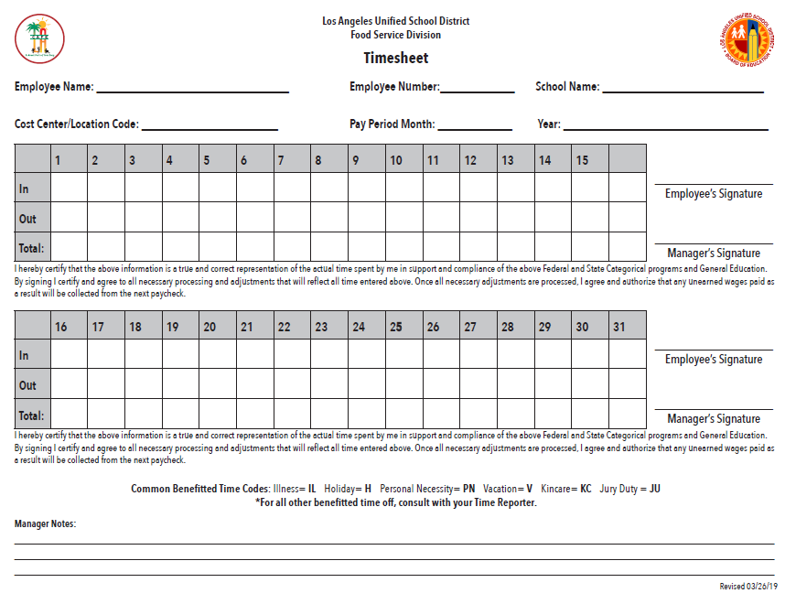
TIMECARD VS. TIMESHEET
Timecard
Official District time reporting document
Maintained in the main office
Refer to FSD Handbook page 40
Timesheet
Official Food Service Division (FSD) document
Maintained in the cafeteria
Refer to FSD Handbook page 40
Notes:
For audit purposes, these two documents must match.
The FSD Timesheet is also used when an employee is reassigned to home, reassigned to another school site, and during the AWOL process.
The FSD Timesheet(s) and PC 5096, Unauthorized Absence Worksheet, are sent to the Personnel Commission.
The timekeeper/SAA is responsible for maintaining the timecards.
The Principal is responsible for certifying time and at some school sites will sign off on the timecard.

Slide 4
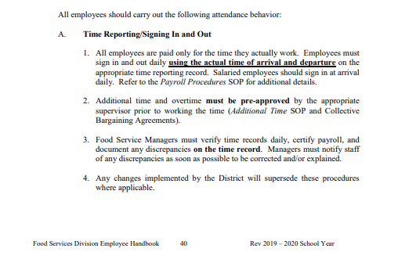
TIME REPORTING/SIGNING IN AND OUT
Enter the actual time worked on the Timecards and Timesheets.
Employees who are late to work cannot make up time at the end of their shift.
If work is completed, have employees sign out for the day.
If time permits, find extra cleaning or organizing assignments.
Refer to FSD Handbook page 40
Notes:
Do not allow grace period for employees who are late to work. When an employee is late for work, the time is reported as unpaid time.
If an employee abandons their job, the FSM is to write in RED the time the employee left the worksite and initial the change.

Slide 5
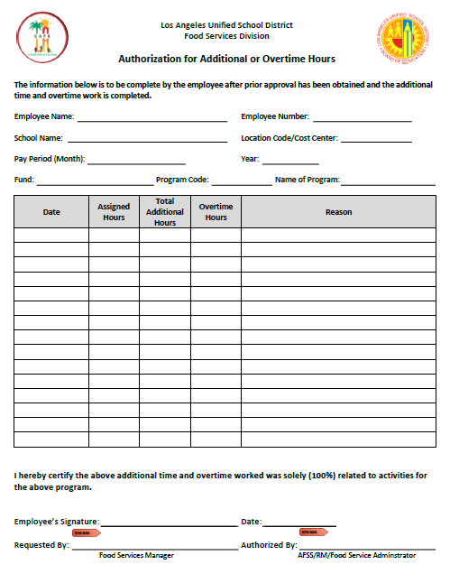
ADDITIONAL TIME
There are times when additional time is necessary.
The FSM is required to obtain approval in advance from AFSS prior to working and/or granting any additional time.
FSM required to complete the Authorization for Additional or Overtime Hours form and send it to the AFSS at the end of the week (Friday) that additional time is worked.
Include the following on the form:
Reason for additional time
How much time required
Name of employee requiring time
Notes:
Based on business necessity, don’t be afraid to ask your AFSS for additional time.
If the cafeteria is short staffed, the FSM should not be penalized for requesting additional time for themselves or their staff.

Slide 6
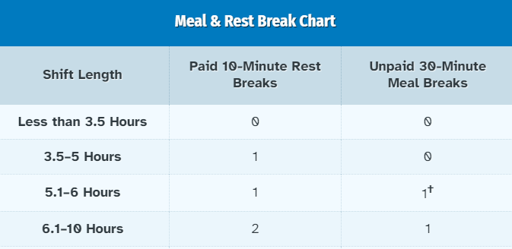
REST/MEAL PERIODS
California law requires mandatory rest/meal periods.
Rest Period (paid)
Four (4) hours—one ten (10) min. break
Five (5) hours—one ten (10) min. break
Six (6) hours– two ten (10) min. breaks
May not be used to shorten the day
Meal Period (unpaid)
Five ½ (5.5)-hour or greater–one (30) min. meal
Do not schedule rest and/or meal periods during the first or last hour of the employee’s shift.
Refer to FSD Handbook pages 36-37 for further clarification
Notes:
Based on manager approval and operational needs, rest periods can be combined into one (1) twenty-minute break.
Everyone in the cafeteria either takes two (2) 10-minute breaks or one (1) twenty-minute break. This must in writing and placed in each employee file.
A five and a half (5.5)—hour employee is entitled to one ten (10)—minute break.
A five and a half (5.5)—hour or greater employee receives one (1) thirty (30) minute meal period.
Only the 5.5-hour or six 6-hour employee can waive their thirty (30) minute meal period, but the waiver must be in writing and one copy to the SAA, one kept in the employee’s file.
By law, employees with six and half (6.5)-hours or greater are not allowed to waive their meal period.

Slide 7
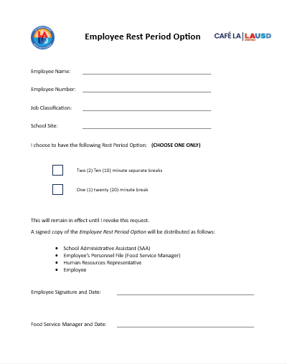
REST/MEAL PERIODS
Employees have the option to choose their rest period.
Employees Complete Information
Employee Name
Employee Number
Job Classification
School Site
Employee Rest Period Option
Employees choose option
Two (2) Ten (10)-minute breaks
One (1) twenty (20) minute break
Distribute copies
SAA
Employee file (FSM)
HR Representative
Employee
Refer to FSD Handbook pages 36-37 for further clarification
Notes:
Employees have the option to choose their rest period. They may choose either two (2) ten (10)—minute separate breaks or combine the two (2) ten (10)—minute breaks into one (1) twenty (20)—minute break. Employees will complete the Employee Rest Period Option in writing and copies will be distributed to: SAA, employee file, HR Representative and employee .

Slide 8
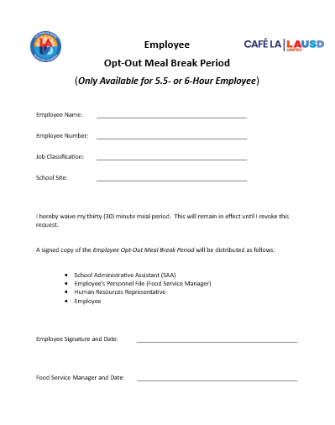
REST/MEAL PERIODS
Only 5.5 or 6-hour employees have the option to waive their meal break period.
Employees Complete Information
Employee Name
Employee Number
Job Classification
School Site
Employee Opt-Out Meal Break
Only applies to 5.5 or 6-hour
Distribute copies
SAA
Employee file (FSM)
HR Representative
Employee
Refer to FSD Handbook pages 36-37 for further clarification
Notes:
Only the 5.5-hour or six 6-hour employee can waive their thirty (30) minute meal period, but the waiver must be in writing in writing and copies will be distributed to: SAA, employee file, HR Representative and employee . It will remain valid until the employee revokes their Opt-Out Meal Break Period in writing.
By law, employees with six and half (6.5)-hours or greater are not allowed to waive their meal period.

Slide 9
REST/MEAL PERIODS
Meal periods are unpaid and are the employee’s personal time.
Breaks are paid by the District, and employees are to remain on company property.
Employees may leave the property on their personal time but must return to work on time.
If a FSW or FSM is leaving the school site for their meal period, the FSM must notify both the AFSS and the Principal.
Refer to FSD Handbook pages 36-37 for further clarification
Notes:
The District does not allow smoking on the property. If an employee chooses to smoke in their car, their car cannot be on District property.
Furthermore, as stated previously, breaks are paid by the District and employees must remain on property.
The AFSS will work with the managers to make sure breaks for their staff are posted.

Slide 10
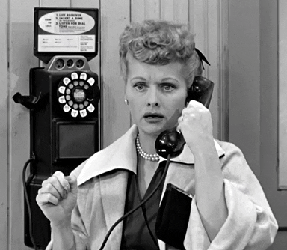
ABSENCE PROCEDURES
It is important to understand the procedures for when employees are absent from work.
Employee must call their manager to report his/her absence every day*
*Exceptions for calling in every day
*Exceptions for calling in every day
Doctor’s Note placing off work
Work-related injury
Work Status Report with or without restrictions
Completed Certification of Absence form
Completed PC Form 5006 Leave of Absence for Classified Employees
Refer to FSD Handbook page 41 for further clarification
Notes:
Employee must call their manager to report his/her absence every day, unless the employee’s health care provider has specifically placed the employee on a documented absence or an extended leave, i.e., employee has incurred a work-related injury, employee has Work Status Report with/without work restrictions, employee has completed the Certification of Absence form, or employee has completed PC Form 5006 Leave of Absence for Classified Employees.

Slide 11
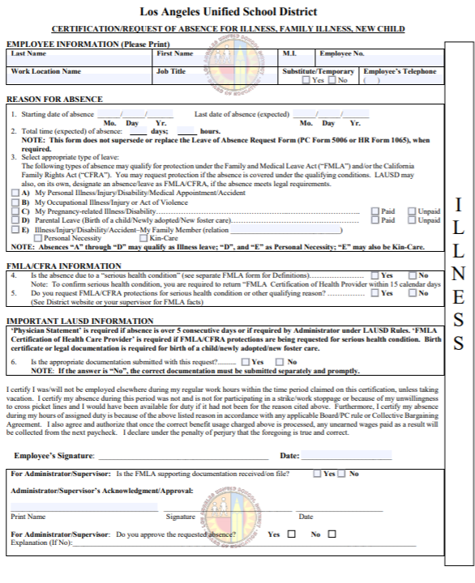
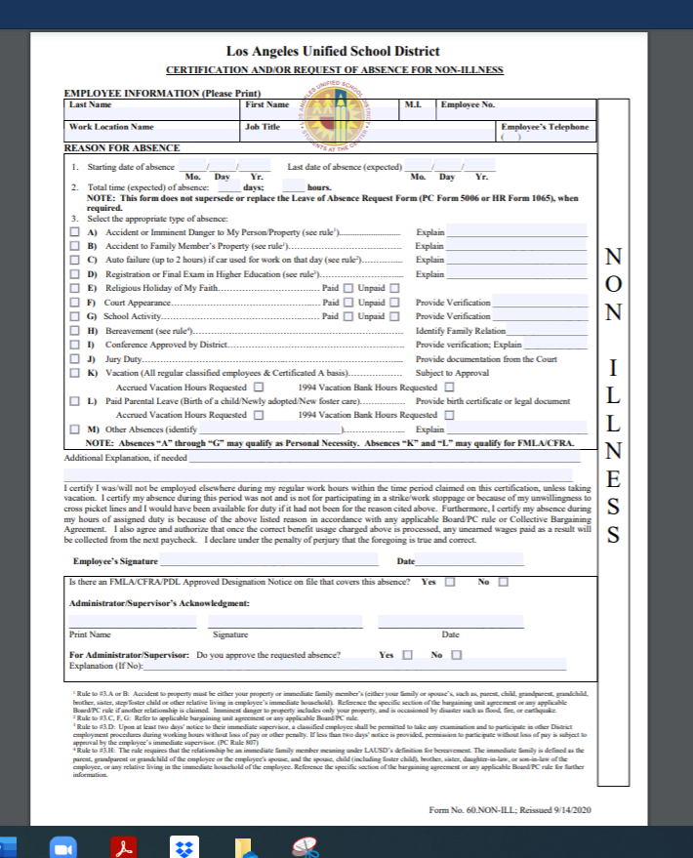
ABSENCE PROCEDURES
It is important to understand the procedures for when employees are absent from work.
It is the employee’s responsibility to submit all Certification Of Absence forms
AFSS and/or Principal may sign the Certification of Absence Form
The employee remains Unpaid (UP) until they have submitted documentation for their absence
ILLNESS
NON-ILLNESS
Refer to FSD Handbook page 41 for further clarification
Notes:
FSMs should not report time without documentation (i.e.—Certification of Absences Forms, Work Status Report, Doctor’s Note, etc.).

Slide 12
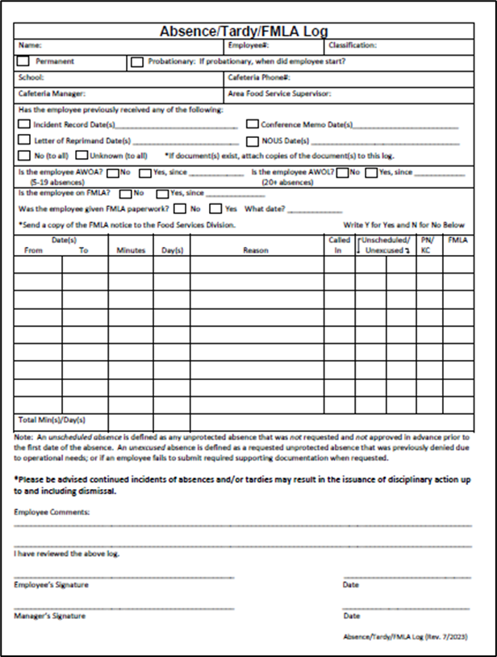
ABSENCE PROCEDURES
It is important to understand the procedures for when employees are absent from work.
Record all absences and tardies on the Absence/Tardy/FMLA Log
Failure to report absences daily, submit documentation, or being late to work may warrant corrective action
Refer to FSD Handbook page 41-42 for further clarification

Slide 13
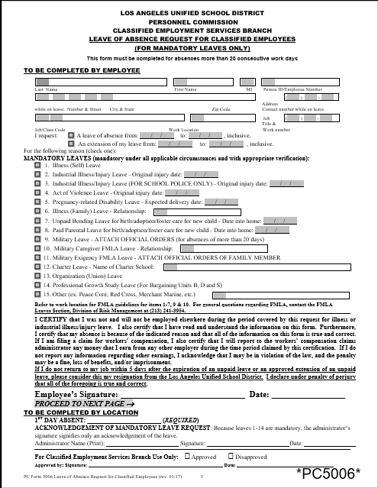
ABSENCE PROCEDURES
Employees absent for more than 20 consecutive workdays must comply with the Personnel Commission Rule (PC Rule 803, Section D) and submit a Leave Of Absence Request for Classified Employees (PC Form 5006) along with any supporting documents as required.
Send both PC Forms and FMLA Forms to FSD HR.
FMLA forms are processed by your HR Rep.
Refer to FSD Handbook page 42 for further clarification
Notes:
FSM can send both PC Forms and FMLA forms to the HR Representative who will forward the appropriate forms to the Personnel Commission, if necessary.

Slide 14
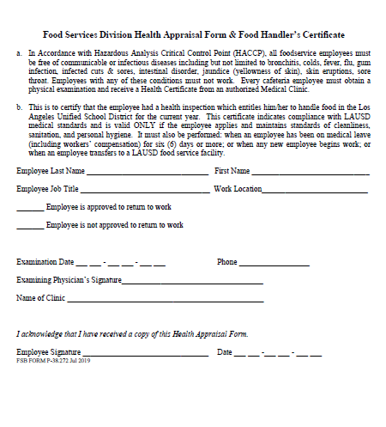
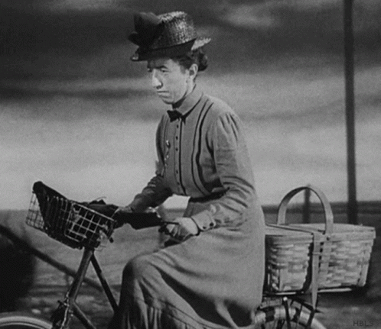
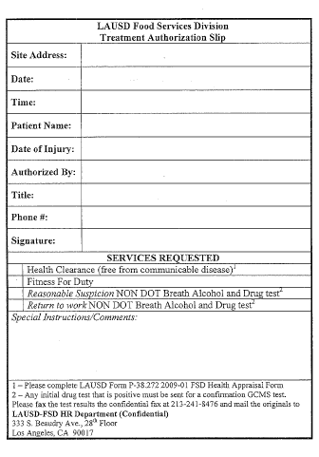
RETURN TO WORK FROM ABSENCE
Returning to work from an absence is not necessarily simple.
Prior to returning to site:
When to seek District Doctor:
Employee must call supervisor at least one (1) hour before end of their regular workday
If absence more than five (5) consecutive working days
Employee must submit a Doctor’s Note and a completed Health Appraisal Form to the District Doctor
If a substitute has been assigned and the employee fails to follow the procedure, the substitute will be retained, and the employee will be sent home and unpaid for the day.
The manager completes the Treatment Authorization Slip for employee
The employee remains in unpaid status until they have been cleared to return to work
If the employee is on LOA, Treatment Authorization Slip comes from PC.
Refer to FSD Handbook pages 41-42 for further clarification
Notes:
A doctor’s note is required prior to returning if an absence is six (6) consecutive workdays or more. The FSM must give the employee a Health Appraisal Form either in-person or via email. School nurses are also permitted to complete the Health Appraisal Form clearing employees to return to work.
If the employee is on a Leave Of Absence, the Personnel Commission will coordinate the District Doctor visit for the employee.

Slide 15
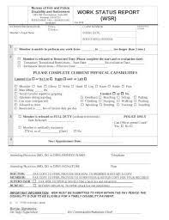
RETURN TO WORK WITH RESTRICTIONS
Employees returning to work with restrictions (temporary/permanent).
Work Status Report:
Employees who are off work due to worker’s compensation or personal injury MUST submit a Work Status Report.
Submit the Doctor’s Work Status Report to the FSM, AFSS and HR Representative to review and determine if the work restrictions can be accommodated.
Refer to FSD Handbook pages 41-42 for further clarification
Notes:
Include the HR Representative in determining if the work restrictions can be accommodated.
The purpose for including the HR Rep is to avoid any District liability and/or potential discrimination.

Slide 16
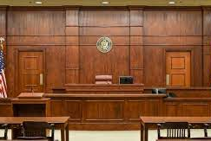
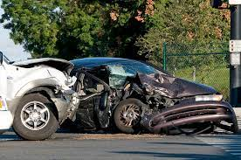
TYPES OF LEAVES OF ABSENCES
Personal Necessity (PN) is deducted from accrued Full Pay Illness and time must be approved prior to being taken per fiscal year (July—June).
Teamsters 572 receives seven (7) days; SEIU Local 99 receives six (6) days.
Protected Absences
Unprotected Absences
Religious Holiday of the Employee’s Faith
Appearance in Court as a Litigant or Witness Under Subpoena
School Activities*
Accident involving staff person or property
Imminent danger to home due to disaster
Other significant event of a compelling nature to the employee
One day for taking registration or final exam in District recognized institutions of higher learning
Refer to FSD Handbook page 41 for further clarification
Notes:
If no Full Pay Illness is available, time cannot be reported as PN.
For School Activities, see the appropriate Collective Bargaining Agreement
PN is not confidential, and FSM has the right know the reason for the PN request to determine if leave is protected or unprotected.
*SCHOOL ACTIVITIES (Optional to read CBA language in both Teamsters Article XIII, m. and SEIU Article XIII, 13.0, k.)
“Up to one (1) day of paid personal necessity leave and additional hours of accrued vacation or unpaid not to exceed a total of eight (8) hours per calendar month, forty (40) hours per school year for attendance at the school of their employee’s own child, ward, or grandchild for the purposes of a school activities leave. The employee must notify the administrator or designee at least five (5) working days prior to the absence.”

Slide 17
TYPES OF LEAVES OF ABSENCES
Emergency Vehicle Breakdown (PN)
Verifiable automobile failure including flat tires up to two (2) hours if the employee’s automobile is required to be used for work purposes on that day.
Teamsters 572 Members should refer to Article XIII– Leaves of Absences, 13.0, Personal Necessity Leave (Paid), i.
SEIU Local 99 Members should refer to Article XII, 13.0 Personal Necessity Leave (Paid), g.
Refer to union contract language or contact your HR Representative
Notes:
If no Full Pay Illness is available, time cannot be reported as PN.
PN is not confidential, and FSM has the right know the reason for the PN request to determine if leave is protected or unprotected.

Slide 18
TYPES OF LEAVES OF ABSENCES
Kin Care (KC) six (6) days is deducted from accrued Full Pay Illness and time must be approved prior to being taken.
Kin Care (KC) six (6) days per calendar year (January – December) to attend to the illness of a qualifying family member illustrated below.
Registered Domestic Partner
Parent
Child
Spouse
Refer to FSD Handbook page 41 for further clarification
Notes:
If no Full Pay Illness is available, time cannot be reported as KC.
Qualifying family member for Kin Care are parent, child, spouse, or registered domestic partner.

Slide 19
TYPES OF LEAVES OF ABSENCES
Bereavement Leave provides five (5) days of job-protected leave to District employees for the death of a qualifying family member.
Bereavement Pay
Qualifying Family Member
Five (5) Days (In-state)
Three (3) paid days
Two (2) additional days
Vacation
Personal Necessity
Unpaid
Spouse
Child
Parent
Sibling
Grandparent
Parent-In-Law
Designated person
Any relative in immediate household
Five (5) Days (Out of state)
Five (5) paid days
Refer to Bereavement Leave Frequently Asked Questions
Notes:
Designated person will be described in a future District Bulletin.

Slide 20
CALL BACK TIME
Employees who are called back to work outside of their regular work hours shall be guaranteed a minimum of two (2) hours pay at the appropriate rate with State and Federal Law.
Teamsters 572 Members should refer to Article IX– Hours of Work, 3.0, Call Back Time.
SEIU Local 99 Members should refer to Article IX Hours and Overtime, 5.0 Call Back Time
Refer to union contract language or contact your HR Representative
Notes:
Only call employees back to work in an extreme emergency. Avoid using Call Back Time whenever possible.

Slide 21
MY PROFESSIONAL LEARNING NETWORK
My Professional Learning Network (MyPLN) has been developed and designed to offer LAUSD employees a wide array of diverse learning opportunities including in-person, virtual, and blended learning professional development.
MyPLN training is to be completed while on duty.
MyPLN training is not performed during break or meal periods.
FSM designate time(s) for staff to complete trainings.
https://www.lausd.org/cms/lib/CA01000043/Centricity/domain/644/__mypln_login/
Notes:
Since MyPLN is a District requirement, the FSM supplies the time and equipment (computer) for My PLN training. Additionally, MyPLN is not conducted during the meal or rest period.
DO NOT DIRECT EMPLOYEES TO COMPLETE MYPLN AT HOME.

Slide 22
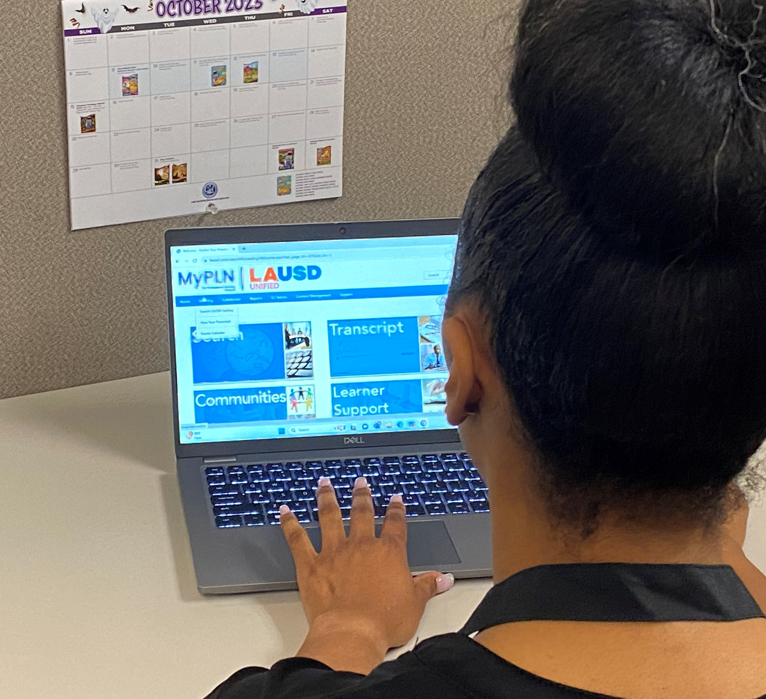
ACCESSING TRAININGS IN MYPLN
LAUSD employees can access trainings through the MyPLN website.
How to access MyPLN training:
Log into MyPLN
https://www.lausd.org/cms/lib/CA01000043/Centricity/domain/644/__mypln_login/

Slide 23
ACCESSING TRAININGS IN MYPLN
LAUSD employees can access trainings through the MyPLN website.
How to access MyPLN training:
Log into MyPLN
On the home screen, (click) on the Transcript tab
https://www.lausd.org/cms/lib/CA01000043/Centricity/domain/644/__mypln_login/

Slide 24
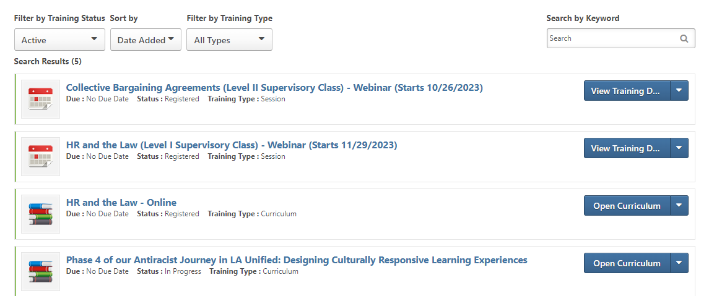
ACCESSING TRAININGS IN MYPLN
LAUSD employees can access trainings through the MyPLN website.
How to access MyPLN training:
Log into MyPLN
On the home screen, (click) on the Transcript tab
The Welcome to your Transcript will display classes and/or trainings to be completed

Slide 25
QUESTIONS

